Slide 1
Lecture # 2 (Final) Pulse Width Modulation (PWM)

Slide 2
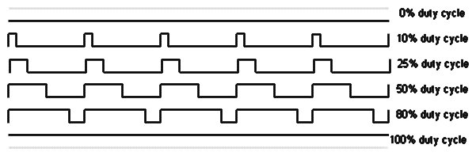
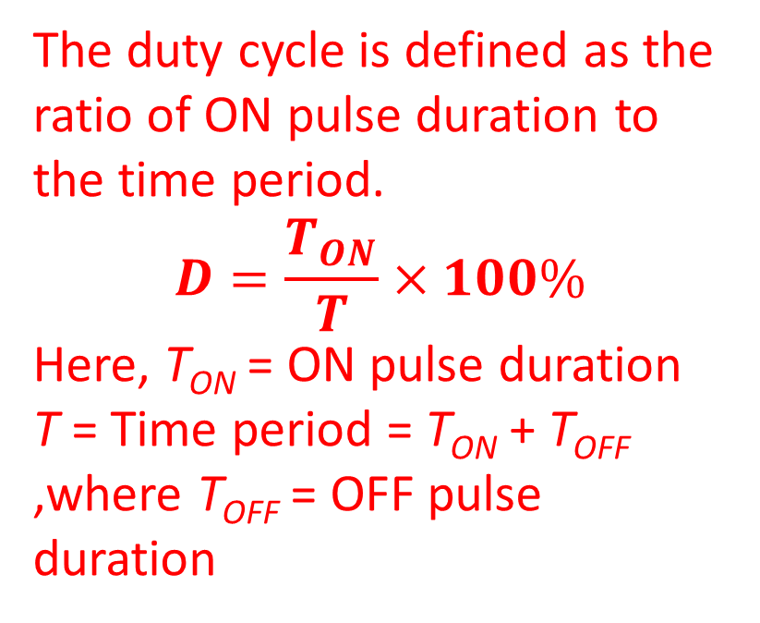
PWM
Pulse Width Modulation, or PWM, is a technique for getting analog results with digital means. Digital control is used to create a square wave, a signal switched between on and off. This on-off pattern can simulate voltages in between the full V_{CC} of the board (e.g., 5 V on UNO) and off (0 Volts). The duration of "on time" is called the pulse width. To get varying analog values, the pulse width can be varied. If this on-off pattern is repeated fast enough with an LED, for example, the result is as if the signal is a steady voltage between 0 and V_{CC} controlling the brightness of the LED.
The duty cycle is defined as the ratio of ON pulse duration to the time period.
$$D=\frac{T_{ON}}{T}×100\%$$
Here, T_{ON} = ON pulse duration
T = Time period = T_{ON} + T_{OFF} ,where T_{OFF} = OFF pulse duration
T_{ON}
T_{OFF}

Slide 3
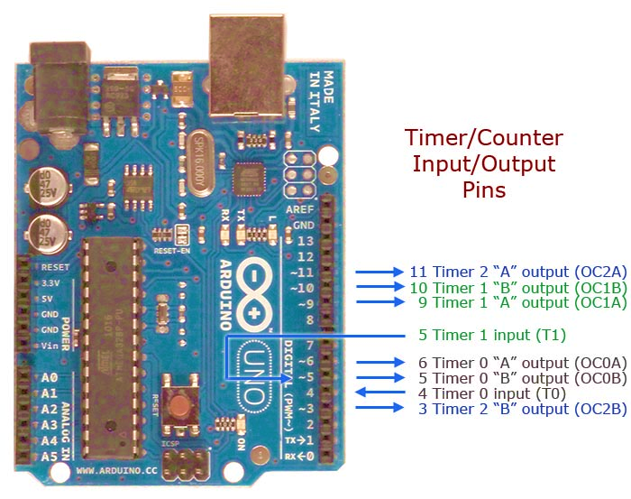
PWM
PWM
The Arduino’s programming language makes PWM easy to use; simply call the built-in function analogWrite(pin, dutyCycle), where dutyCycle is a value from 0 to 255, and pin is one of the PWM pins (3, 5, 6, 9, 10, or 11).
The analogWrite() function provides a simple interface to the hardware PWM but doesn’t provide any control over frequency.
Note the tilde ~ sign with the pin numbers of the image with the PWM pins.
The mappings of the PWM pins with the timers are 3>>OC2B, 5>>OC0B, 6>>OC0A, 9>>OC1A, 10>>OC1B, and 11>>OC2A).

Slide 4
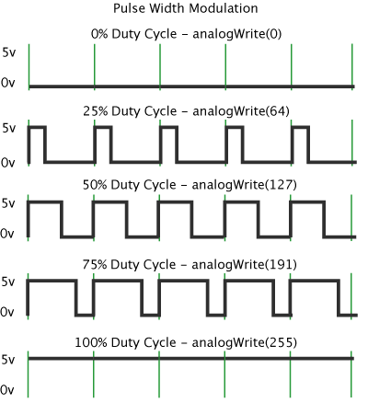
PWM
PWM
In the graphic below, the green lines represent a regular time period. This duration or period is the inverse of the PWM frequency. In other words, with Arduino's PWM frequency at about 500 Hz, the green lines would measure 2 ms in each interval.
A call to analogWrite() is on a scale of 0-255 (int data type), such that analogWrite(255) requests a 100% duty cycle (always ON), whereas analogWrite(0) requests a 0% duty cycle (always OFF), and analogWrite(127) is a 50% duty cycle (50% ON time of a time period) for example.

Slide 5
PWM
PWM: Example # 1
int ledPin = 9; // LED connected to digital pin 9 (8-bit data)
int analogPin = A3; // potentiometer connected to analog pin 3 (A3) to read analog voltage
int val = 0; // variable to store the read value in 10-bit digital data format (analog data is
// converted to digital data by the 10-bit ADC module of the microcontroller)
void setup() {
pinMode(ledPin, OUTPUT); // sets the pin as output
}
void loop() {
val = analogRead(analogPin); // read the input pin
analogWrite(ledPin, val / 4); // analogRead values go from 0 to 1023, analogWrite values from 0 to 255
}
Notes on Boards Capabilities:
Boards with an 8-bit PWM resolution are capable of slicing the PWM duty cycle on 255 steps.
Boards with a 10-bit PWM resolution are capable of slicing the PWM duty cycle on 1024 steps.
Boards with a 12-bit PWM resolution are capable of slicing the PWM duty cycle on 4095 steps.
Boards with a 16-bit PWM resolution are capable of slicing the PWM duty cycle on 65536 steps.
* 1024/256 = 4

Slide 6
PWM
PWM: Example # 2
Notes on map():
Re-maps a number from one range to another. That is, a value of fromLow would get mapped to toLow, a value of fromHigh to toHigh, values in-between to values in-between, etc.
Does not constrain values to within the range, because out-of-range values are sometimes intended and useful. The constrain() function may be used either before or after this function, if limits to the ranges are desired.
Note that the "lower bounds" of either range may be larger or smaller than the "upper bounds", so the map() function may be used to reverse a range of numbers, for example
y = map(x, 1, 50, 50, 1);
The function also handles negative numbers well, so that the following example is also valid and works well.
y = map(x, 1, 50, 50, -100);
The map() function uses integer math so will not generate fractions, when the math might indicate that it should do so. Fractional remainders are truncated and are not rounded or averaged.
// Constants
const float V_REF = 5.0; // Analog reference voltage (e.g., 5V or 3.3V)
const float R_BITS = 10.0; // ADC resolution (bits)
const float ADC_STEPS = (1 << int(R_BITS)) - 1; // Number of steps (2^R_BITS - 1)
const int potentiometerPin = A3; // Potentiometer wiper connected to analog pin A3
void setup() {
Serial.begin(9600); // Initialize serial communication
Serial.println(ADC_STEPS); }
void loop() {
int rawValue = analogRead(potentiometerPin); // Read the analog input
float voltage = (rawValue / ADC_STEPS) * V_REF; // Convert to voltage
Serial.print("Voltage: ");
Serial.print(voltage, 3); // Print voltage with 3 decimal places
Serial.println(" V");
delay(200); // Small delay to avoid flooding the serial monitor
}

Slide 7
PWM
PWM: Example # 3
Serial.print(" , 8-bit PWM value : ");
Serial.print(map(sensorVal, 0, 1023, 0, 255));
// change the PWM resolution to 12 bits
analogWriteResolution(12);
analogWrite(12, map(sensorVal, 0, 1023, 0, 4095));
Serial.print(" , 12-bit PWM value : ");
Serial.print(map(sensorVal, 0, 1023, 0, 4095));
// change the PWM resolution to 4 bits
analogWriteResolution(4);
analogWrite(13, map(sensorVal, 0, 1023, 0, 15));
Serial.print(", 4-bit PWM value : ");
Serial.println(map(sensorVal, 0, 1023, 0, 15));
delay(5);
}
void setup() {
Serial.begin(9600); // open a serial connection
pinMode(11, OUTPUT); // make 3 digital pins as output pins
pinMode(12, OUTPUT);
pinMode(13, OUTPUT);
}
void loop() {
int sensorVal = analogRead(A0); // read the analog data
Serial.print("Analog Read : ");
Serial.print(sensorVal);
analogWriteResolution(8); // the default PWM resolution
// read the input on A0 pin and map it to a PWM pin
analogWrite(11, map(sensorVal, 0, 1023, 0, 255));

Slide 8


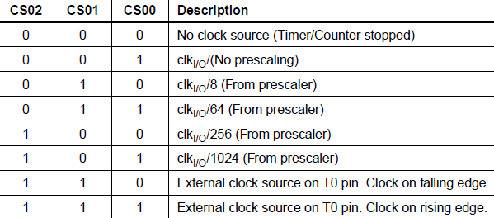


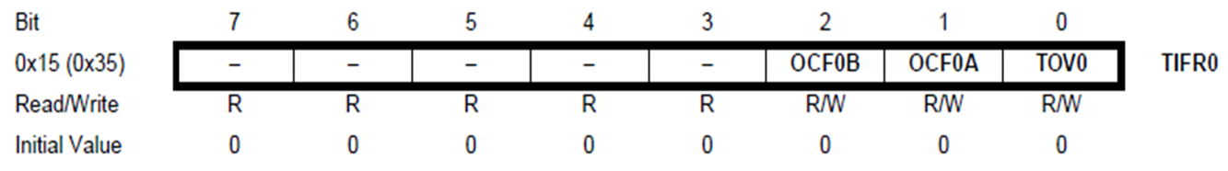

PWM
PWM
The main PWM modes are "Fast PWM" and "Phase-correct PWM“.
There are two Fast PWM modes for Timer/Counter 0 unit. These are modes 3 and 7, which are selected using the waveform generation mode bits (WGM02, WGM01, and WGM00). The WGM01 and WGM00 bits are located in the TCCR0A register. The WGM02 bit is located in the TCCR0B register.
There are 2 types of Fast PWM modes: (a) Non-inverting and (b) Inverting Fast PWM

Slide 9
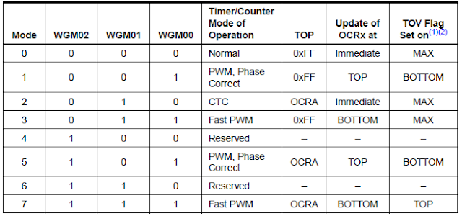
PWM
The difference between the mode 3 and mode 7 Fast PWMs is their TOP values.
For mode 3, the TOP value is fixed (0xFF), whereas that for mode 7 is OCRnA value.
So, if mode 7 is used then we must load a count value into the OCRnA register.
Once a mode is selected, the timer/counter starts counting from BOTTOM to TOP value and when the TOP value is reached the counting is repeated from BOTTOM.
The table in the right shows the WGM bits combination for mode 3 and mode 7.

Slide 10
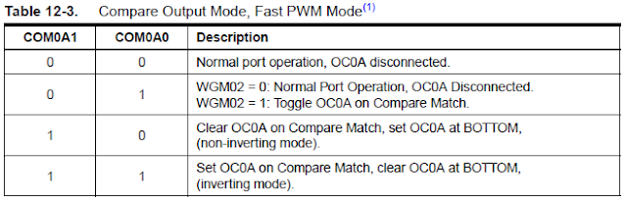
Fast PWM Mode: Setting Modes
In the fast PWM mode, the Compare Output Mode bits COM0A1, COM0A0 (in the TCCR0A register) for the output at OC0A and bits COM0B1, COM0B0 (in the TCCR0A register) for the output at OC0B, are used to configure the output as either non-inverting or inverting mode of operation. Table 12-3 shows how to select COM0A1, COM0A0 bits to generate non-inverting and inverting mode’s fast PWM waveform.

Slide 11

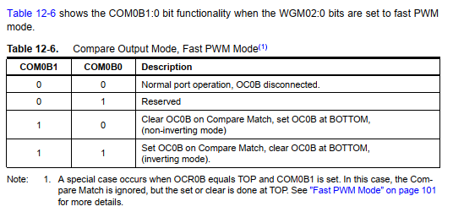
Fast PWM Mode: Setting Modes
In the fast PWM mode, the compare unit allows the generation of PWM waveforms on the OC0x pins. Table 12.6 shows the COM0B1:0 bits’ functionality when the WGM02:0 bits are set to the fast PWM mode.

Slide 12
Fast PWM Mode: Setting Modes
Setting the COM0x1:0 bits to 10 will produce a non-inverted PWM and an inverted PWM output can be generated by setting the COM0x1:0 to 11.
Setting the COM0A1:0 bits to 01 allows the OC0A pin to toggle on Compare Matches if the WGM02 bit is set. This option is not available for the OC0B pin (see Table 12-6 ).

Slide 13
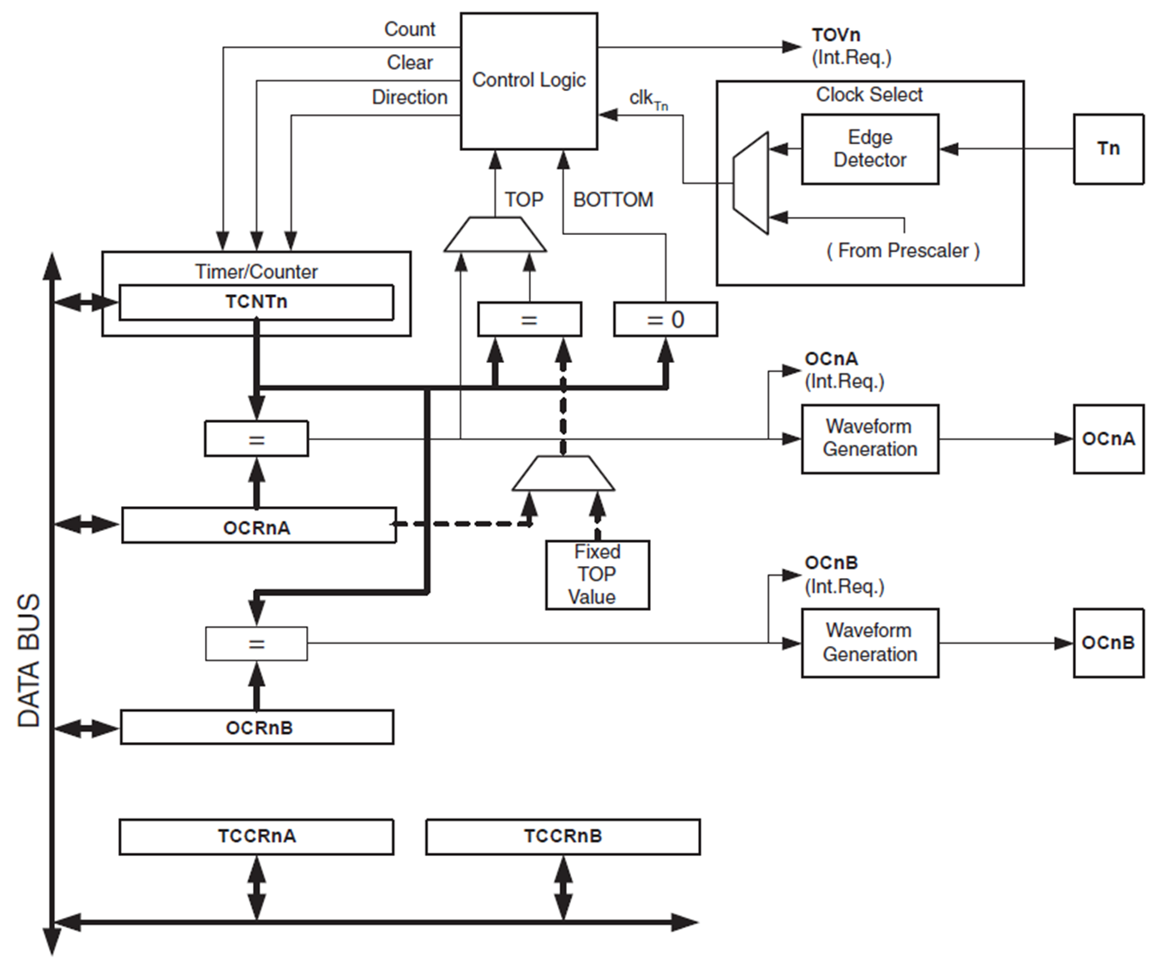
Fast PWM Mode
The Fast Pulse Width Modulation or Fast PWM Mode (WGM02:0 = 3 or 7) provides a high-frequency PWM waveform generation option. The Fast PWM differs from the other PWM option in its single-slope operation.
The counter starts counting from BOTTOM to TOP and then restarts from BOTTOM.
In Non-inverting Compare Output Mode, the Output Compare (OC0x) is cleared on the compare match between TCNT0 and OCR0x and set at BOTTOM.
In Inverting Compare Output Mode, the output is set on compare match and cleared at BOTTOM.

Slide 14
Fast PWM Mode
Due to the single-slope operation, the operating frequency of the Fast PWM mode can be twice as high as the phase correct PWM mode that uses dual-slope operation.
This high frequency makes the fast PWM mode well suited for power regulation, rectification, and DAC applications.
High frequency allows physically small-sized external components (coils, capacitors) and therefore reduces the total system cost.
In fast PWM mode, the counter is incremented until the counter value matches the TOP value, the register TCNTn counts from bottom value to maximum value stored in the register OCRn. The counter is then cleared/reset to zero at the following timer clock cycle. If the timer is configured in non-inverting mode, PWM output pin (OCn) goes low when the value of the above two registers matches. The OCn pin becomes HIGH when the TCNTn register reaches at bottom value. In inverting mode, OCn pin behaves opposite to non-inverting mode.

Slide 15
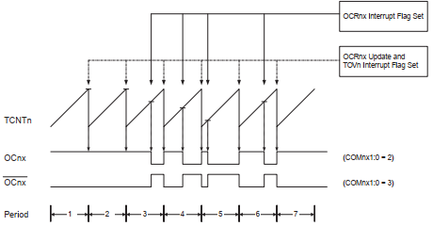

Fast PWM Mode
The timing diagram for the Fast PWM Mode is shown in Figure 12.6.
The TCNT0 value is in the timing diagram shown as a histogram for illustrating the single-slope operation.
The diagram includes both non-inverted and inverted PWM outputs.
The small horizontal line marks on the TCNT0 slopes represent compare matches between OCR0x and TCNT0.
The Timer/Counter Overflow Flag (TOV0) is set each time the counter reaches BOTTOM.
Fig. 12.6 Timing Diagram of Fast PWM Mode

Slide 16
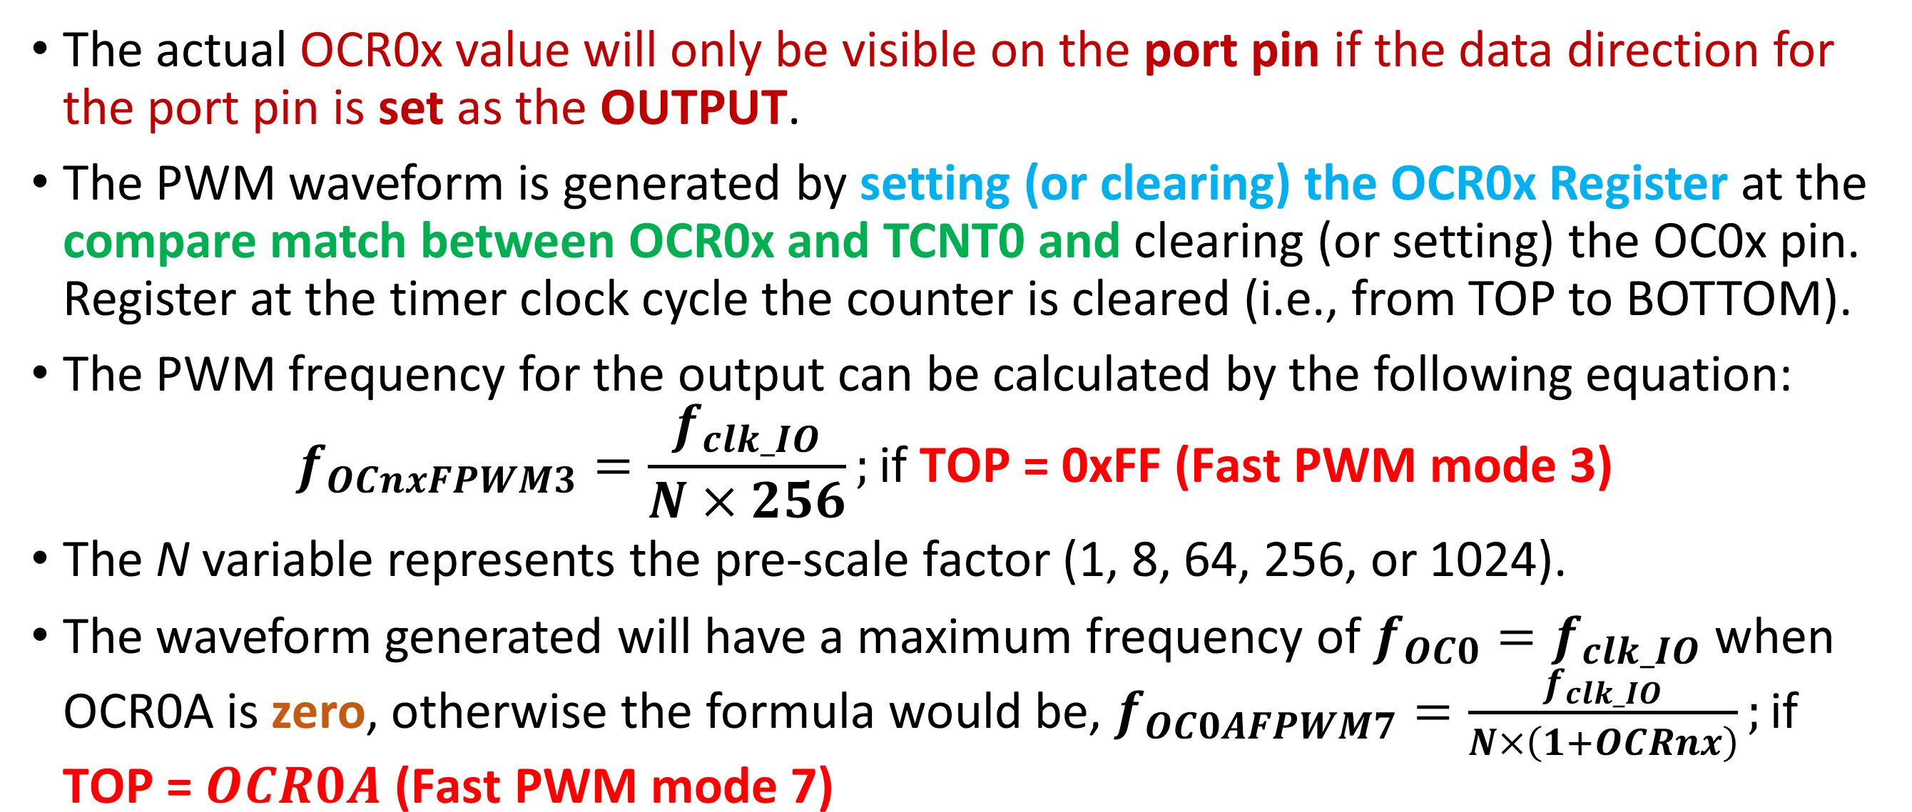
Fast PWM Mode: Output Frequency
The actual OCR0x value will only be visible on the port pin if the data direction for the port pin is set as the OUTPUT.
The PWM waveform is generated by setting (or clearing) the OCR0x Register at the compare match between OCR0x and TCNT0 and clearing (or setting) the OC0x pin. Register at the timer clock cycle the counter is cleared (i.e., from TOP to BOTTOM).
The PWM frequency for the output can be calculated by the following equation:
$$f_{OCnxFPWM3}=\frac{f_{clk_IO}}{N×256};\text{if} \text{TOP}\text{ = 0}\text{xFF}\text{ (}\text{Fast} \text{PWM} \text{mode}\text{ 3)}$$
The N variable represents the pre-scale factor (1, 8, 64, 256, or 1024).
The waveform generated will have a maximum frequency of $f_{OC0}=f_{clk_IO}$ when OCR0A is zero, otherwise the formula would be, $f_{OC0AFPWM7}=\frac{f_{clk_IO}}{N×\left(1+OCRnx\right)};\text{if} \text{TOP}\text{ = }OCR0A \text{(}\text{Fast} \text{PWM} \text{mode}\text{ 7)}$

Slide 17
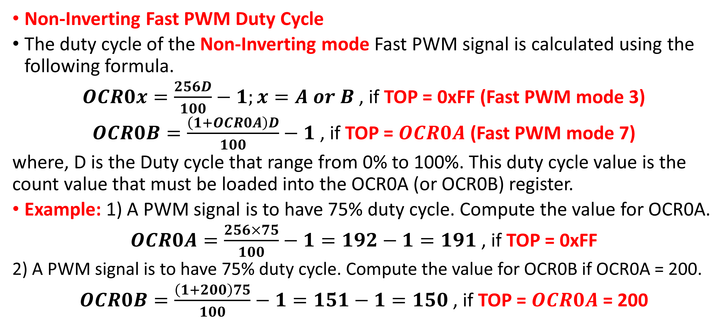
Fast PWM Mode: Output Frequency
Non-Inverting Fast PWM Duty Cycle
The duty cycle of the Non-Inverting mode Fast PWM signal is calculated using the following formula.
$OCR0x=\frac{256D}{100}−1;x=A or B$ , if TOP = 0xFF (Fast PWM mode 3)
$OCR0B=\frac{\left(1+OCR0A\right)D}{100}−1$ , if TOP = $OCR0A$ (Fast PWM mode 7)
where, D is the Duty cycle that range from 0% to 100%. This duty cycle value is the count value that must be loaded into the OCR0A (or OCR0B) register.
Example: 1) A PWM signal is to have 75% duty cycle. Compute the value for OCR0A.
$OCR0A=\frac{256×75}{100}−1=192−1=191$ , if TOP = 0xFF
2) A PWM signal is to have 75% duty cycle. Compute the value for OCR0B if OCR0A = 200.
$OCR0B=\frac{\left(1+200\right)75}{100}−1=151−1=150$ , if TOP = $OCR0A$= 200

Slide 18
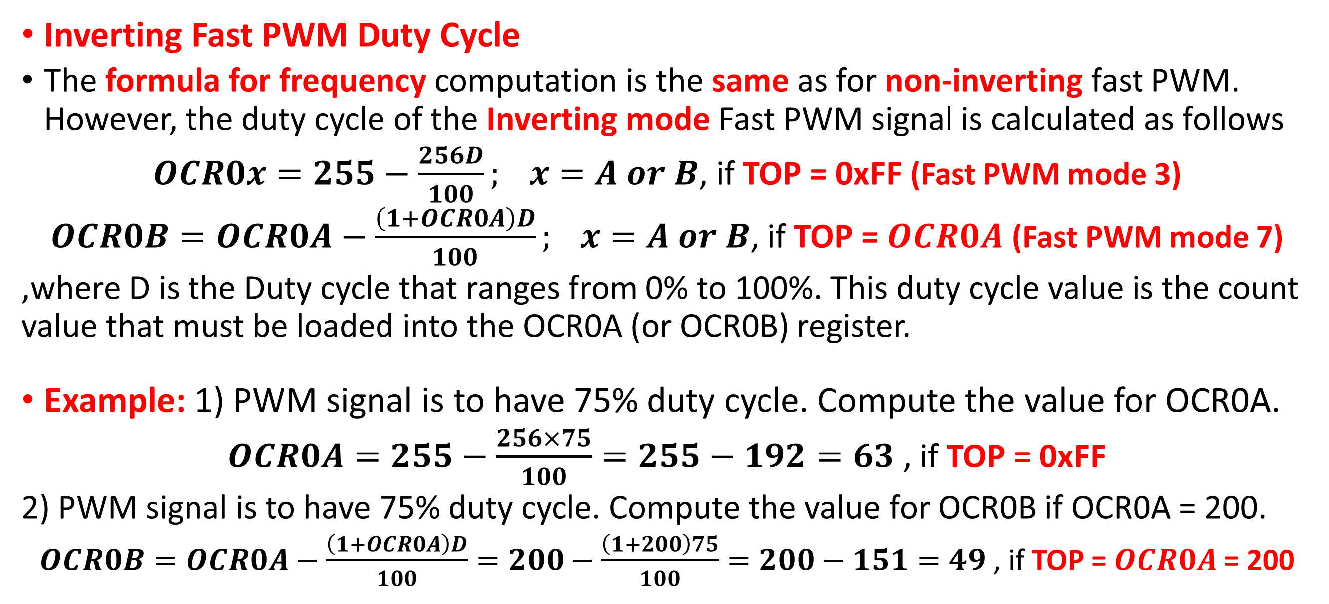
Fast PWM Mode: Output Frequency
Inverting Fast PWM Duty Cycle
The formula for frequency computation is the same as for non-inverting fast PWM. However, the duty cycle of the Inverting mode Fast PWM signal is calculated as follows
$OCR0x=255−\frac{256D}{100}; x=A or B$, if TOP = 0xFF (Fast PWM mode 3)
$OCR0B=OCR0A−\frac{\left(1+OCR0A\right)D}{100}; x=A or B$, if TOP = $OCR0A$ (Fast PWM mode 7)
,where D is the Duty cycle that ranges from 0% to 100%. This duty cycle value is the count value that must be loaded into the OCR0A (or OCR0B) register.
Example: 1) PWM signal is to have 75% duty cycle. Compute the value for OCR0A.
$OCR0A=255−\frac{256×75}{100}=255−192=63$ , if TOP = 0xFF
2) PWM signal is to have 75% duty cycle. Compute the value for OCR0B if OCR0A = 200.
$OCR0B=OCR0A−\frac{\left(1+OCR0A\right)D}{100}=200−\frac{\left(1+200\right)75}{100}=200−151=49$ , if TOP = $OCR0A$= 200

Slide 19
Phase-Correct PWM Mode
The phase-correct PWM mode (WGM02:0 = 1 or 5) provides a high-resolution phase correct PWM waveform generation option. The phase correct PWM mode is based on a dual-slope operation. The counter counts repeatedly from BOTTOM to TOP and then from TOP to BOTTOM.
In non-inverting Compare Output mode, the Output Compare (OC0x) is cleared on the compare match between TCNT0 and OCR0x while up counting and set on the compare match while down counting.
In inverting Output Compare mode, the operation is inverted.
The dual-slope operation has a lower maximum operation frequency than the single-slope operation.
However, due to the symmetric feature of the dual-slope PWM modes, these modes are preferred for motor control applications.

Slide 20
Phase-Correct PWM Mode
In phase-correct PWM mode, the counter is incremented until the counter value matches TOP. When the counter reaches TOP, it changes the count direction.
The TCNT0 value will be equal to TOP for one timer clock cycle. The timing diagram for the phase correct PWM mode is shown on Figure 12.7.
The TCNT0 value is in the timing diagram shown as a histogram for illustrating the dual-slope operation.
The diagram includes non-inverted and inverted PWM outputs.
The small horizontal line marks on the TCNT0 slopes represent compare matches between OCR0x and TCNT0.

Slide 21
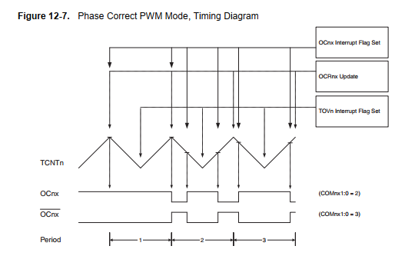
Phase-Correct PWM Mode
The diagram includes non-inverted and inverted PWM outputs.
The small horizontal line marks on the TCNT0 slopes represent compare matches between OCR0x and TCNT0.
The Timer/Counter Overflow Flag (TOV0) is set each time the counter reaches BOTTOM.
The Interrupt Flag can be used to generate an interrupt each time the counter reaches the BOTTOM value.
Figure 12.7 Timing Diagram of the Phase Correct PWM Mode

Slide 22
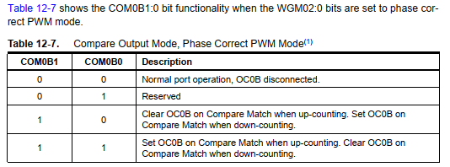
Phase-Correct PWM Mode
In Phase Correct PWM mode, the compare unit allows the generation of PWM waveforms on the OC0x pins. Table 12.7 shows the COM0B1:0 bit functionality when the WGM02:0 bits are set to Phase Correct PWM mode.
Non-inverted PWM Output
Inverted PWM Output

Slide 23
Phase-Correct PWM Mode
In phase-correct PWM mode, the compare unit allows the generation of PWM waveforms on the OC0x pins. Setting the COM0x1:0 bits to 10 will produce a non-inverted PWM output signal.
An inverted PWM output signal can be generated by setting the COM0x1:0 to 11.
Setting the COM0A0 bits to 01 allows the OC0A pin to toggle on Compare Matches if the WGM02 bit is set. This option is not available for the OC0B pin (Table 12-7).

Slide 24
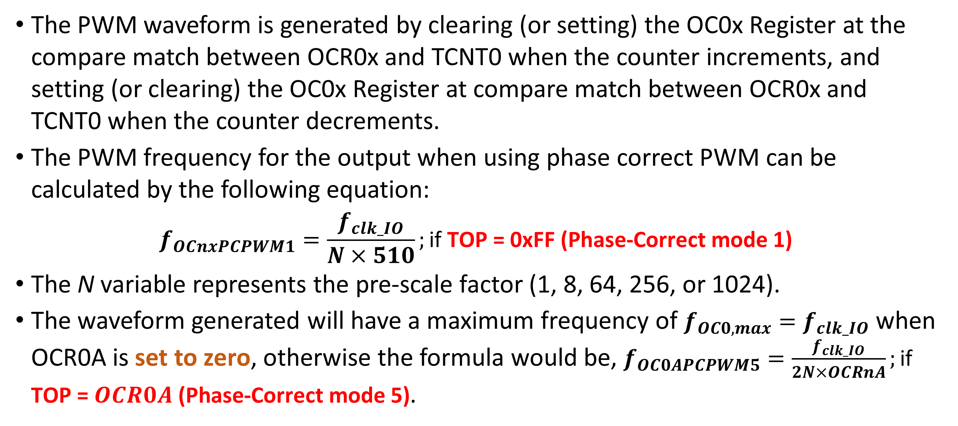
Phase-Correct PWM Mode
The PWM waveform is generated by clearing (or setting) the OC0x Register at the compare match between OCR0x and TCNT0 when the counter increments, and setting (or clearing) the OC0x Register at compare match between OCR0x and TCNT0 when the counter decrements.
The PWM frequency for the output when using phase correct PWM can be calculated by the following equation:
$$f_{OCnxPCPWM1}=\frac{f_{clk_IO}}{N×510};\text{if} \text{TOP}\text{ = 0}\text{xFF}\text{ (}\text{Phase}\text{−}\text{Correct} \text{mode}\text{ 1)}$$
The N variable represents the pre-scale factor (1, 8, 64, 256, or 1024).
The waveform generated will have a maximum frequency of $f_{OC0,max}=f_{clk_IO}$ when OCR0A is set to zero, otherwise the formula would be, $f_{OC0APCPWM5}=\frac{f_{clk_IO}}{2N×OCRnA};\text{if} \text{TOP}\text{ = }OCR0A \text{(}\text{Phase}\text{−}\text{Correct} \text{mode}\text{ 5)}$.

Slide 25
Phase-Correct PWM Mode
The extreme values for the OCR0A Register represent special cases when generating a PWM waveform output in the phase correct PWM mode.
If the OCR0A is set equal to BOTTOM, the output will be continuously low and if set equal to MAX the output will be continuously high for non-inverted PWM mode.
For inverted PWM, the output will have the opposite logic values.

Slide 26
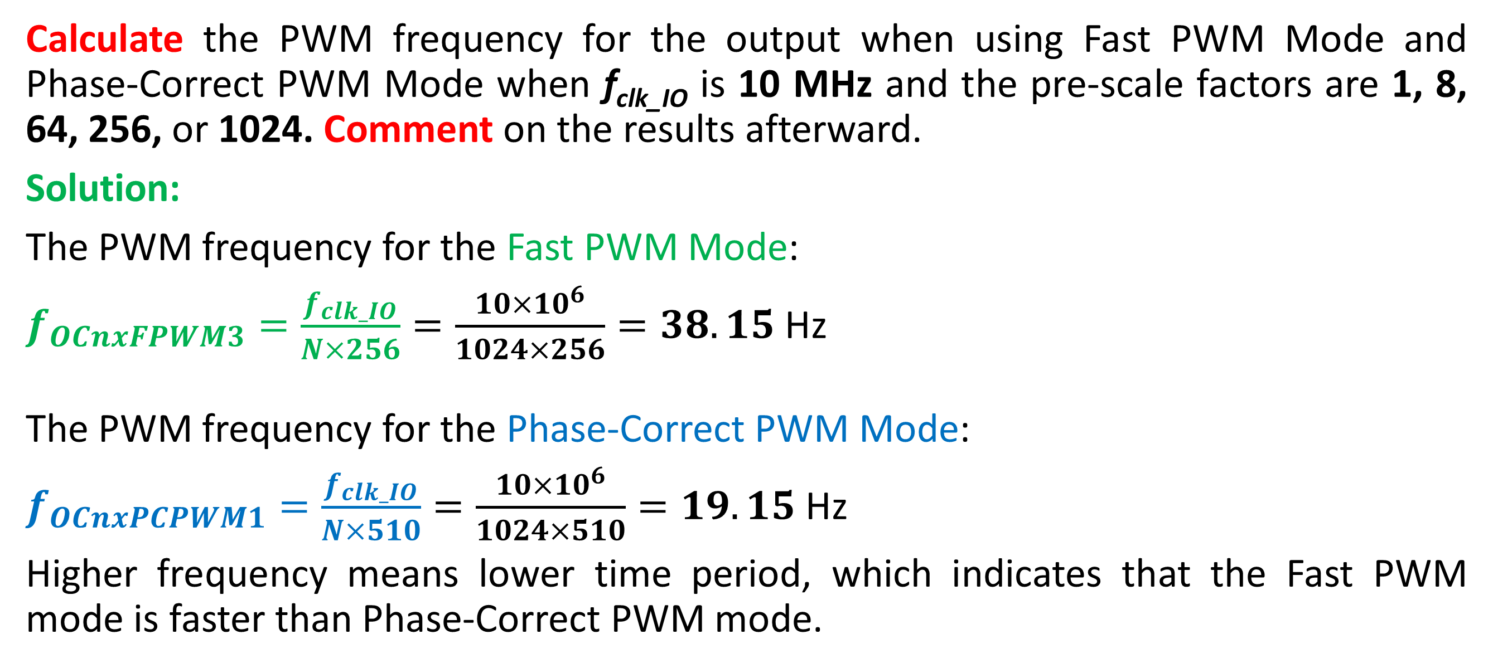
Example to Self-Practice:
Calculate the PWM frequency for the output when using Fast PWM Mode and Phase-Correct PWM Mode when f_{clk_IO} is 10 MHz and the pre-scale factors are 1, 8, 64, 256, or 1024. Comment on the results afterward.
Solution:
The PWM frequency for the Fast PWM Mode:
$f_{OCnxFPWM3}=\frac{f_{clk_IO}}{N×256}=\frac{10×{10}^{6}}{1024×256}=38.15$ Hz
The PWM frequency for the Phase-Correct PWM Mode:
$f_{OCnxPCPWM1}=\frac{f_{clk_IO}}{N×510}=\frac{10×{10}^{6}}{1024×510}=19.15$ Hz
Higher frequency means lower time period, which indicates that the Fast PWM mode is faster than Phase-Correct PWM mode.

Slide 27
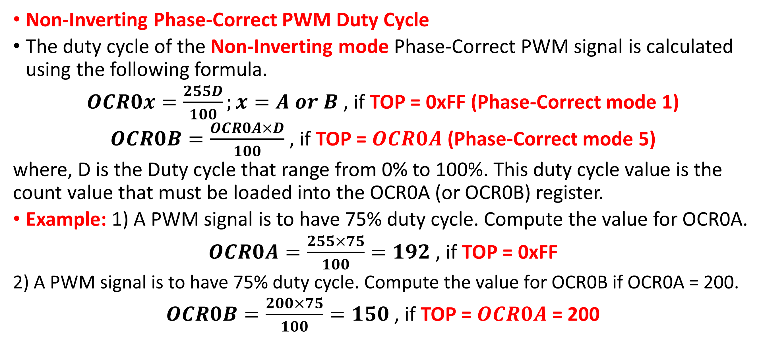
Phase-Correct PWM Mode: Output Frequency
Non-Inverting Phase-Correct PWM Duty Cycle
The duty cycle of the Non-Inverting mode Phase-Correct PWM signal is calculated using the following formula.
$OCR0x=\frac{255D}{100};x=A or B$ , if TOP = 0xFF (Phase-Correct mode 1)
$OCR0B=\frac{OCR0A×D}{100}$ , if TOP = $OCR0A$ (Phase-Correct mode 5)
where, D is the Duty cycle that range from 0% to 100%. This duty cycle value is the count value that must be loaded into the OCR0A (or OCR0B) register.
Example: 1) A PWM signal is to have 75% duty cycle. Compute the value for OCR0A.
$OCR0A=\frac{255×75}{100}=192$ , if TOP = 0xFF
2) A PWM signal is to have 75% duty cycle. Compute the value for OCR0B if OCR0A = 200.
$OCR0B=\frac{200×75}{100}=150$ , if TOP = $OCR0A$= 200

Slide 28
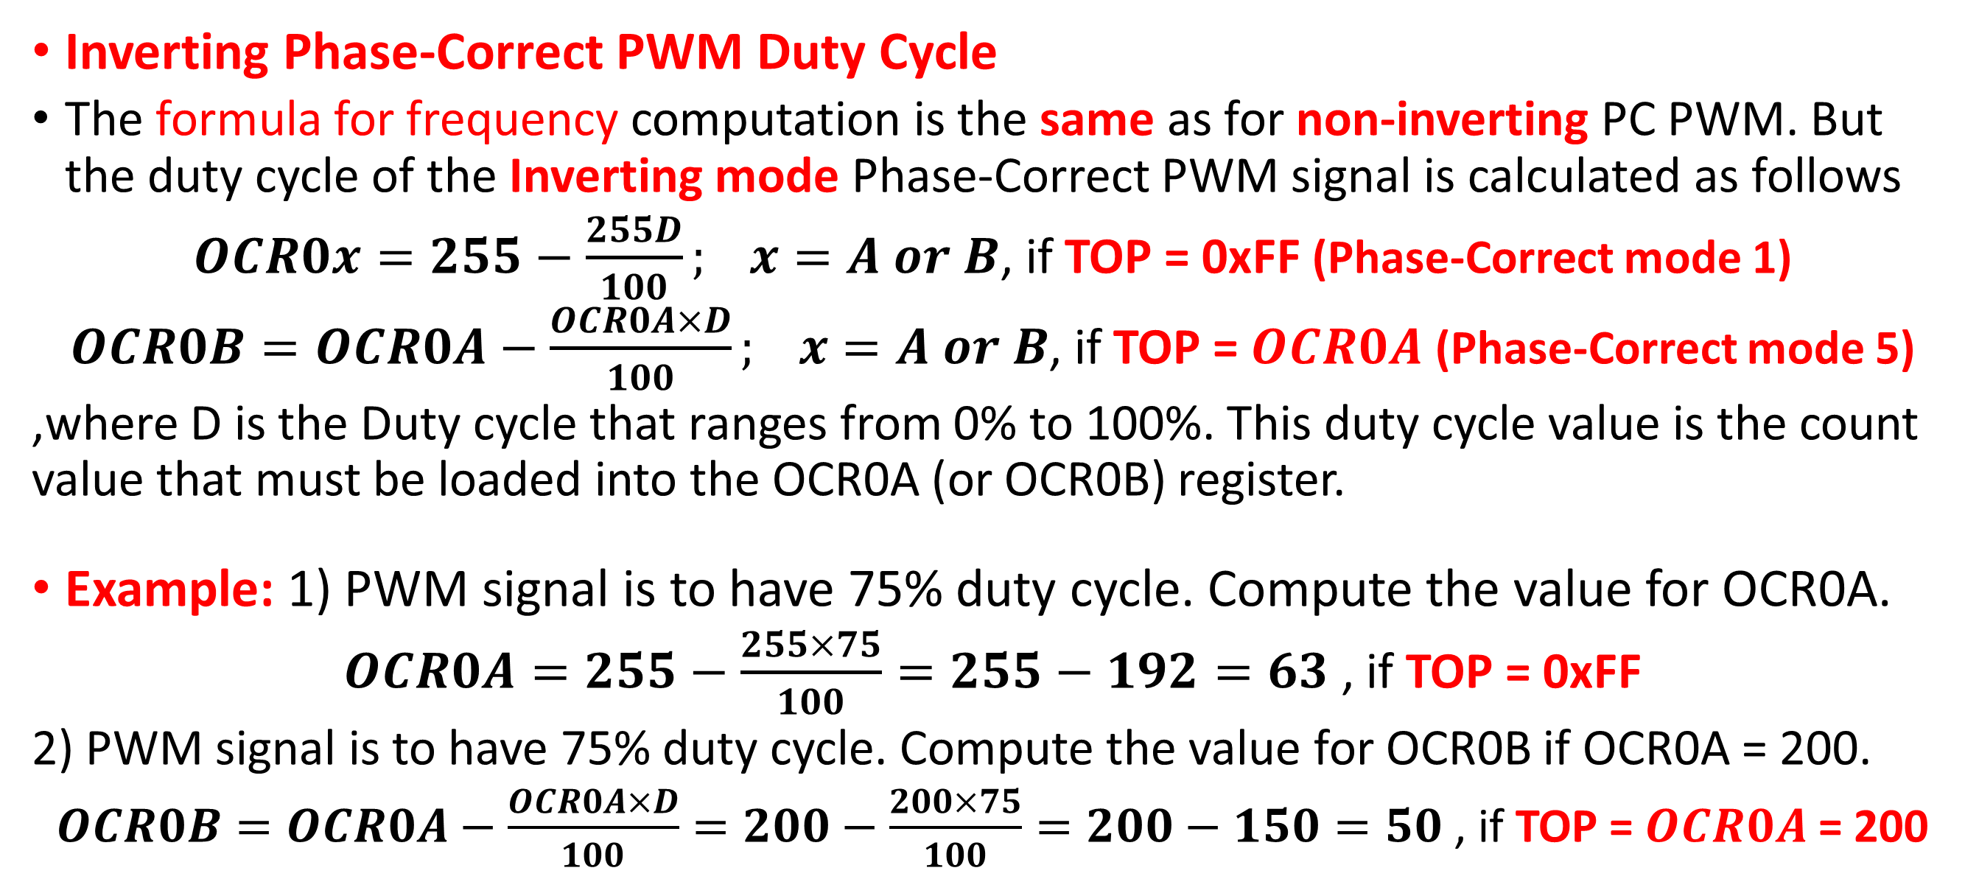
Phase-Correct PWM Mode: Output Frequency
Inverting Phase-Correct PWM Duty Cycle
The formula for frequency computation is the same as for non-inverting PC PWM. But the duty cycle of the Inverting mode Phase-Correct PWM signal is calculated as follows
$OCR0x=255−\frac{255D}{100}; x=A or B$, if TOP = 0xFF (Phase-Correct mode 1)
$OCR0B=OCR0A−\frac{OCR0A×D}{100}; x=A or B$, if TOP = $OCR0A$ (Phase-Correct mode 5)
,where D is the Duty cycle that ranges from 0% to 100%. This duty cycle value is the count value that must be loaded into the OCR0A (or OCR0B) register.
Example: 1) PWM signal is to have 75% duty cycle. Compute the value for OCR0A.
$OCR0A=255−\frac{255×75}{100}=255−192=63$ , if TOP = 0xFF
2) PWM signal is to have 75% duty cycle. Compute the value for OCR0B if OCR0A = 200.
$OCR0B=OCR0A−\frac{OCR0A×D}{100}=200−\frac{200×75}{100}=200−150=50$ , if TOP = $OCR0A$= 200

Slide 29
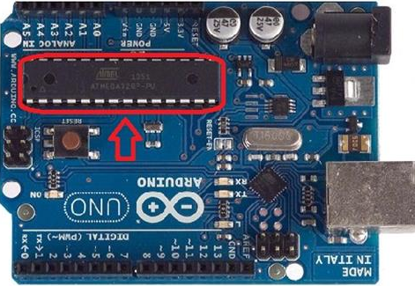
Important!
Note that in those WGM modes where OCR0A sets the frequency (modes 2, 5, and 7) then you can't do PWM on channel A (because OCR0A couldn't be used for two things at once, i.e., setting both PWM frequency and duty cycle!).
So, the only active PWM channel in those modes is channel B and you set the duty cycle of that (as always) with OCR0B (set to some value between 0 and the OCR0A upper limit). As such, the PWM output will be on digital pin 05 (PD5).
The PWM output for channel A with OCR0A will be on digital pin 06 (PD6).

Slide 30
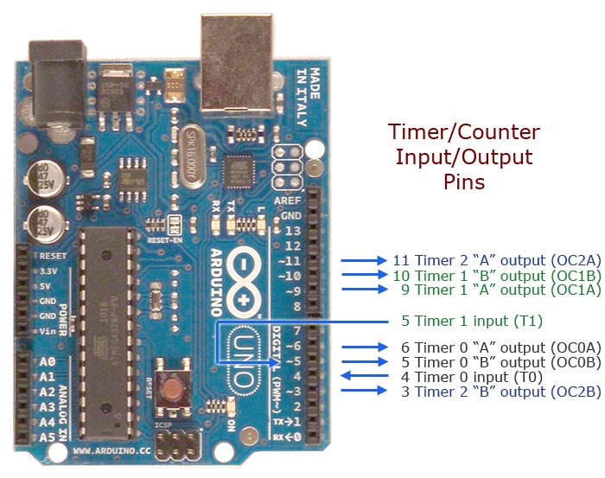


Example for Practice
Use ATmega328p Timer 0 Fast PWM mode 7 with TOP at OCR0A and toggle on OC0A pin (PD06). Calculate the PWM frequency. The frequency changes with OCR0A values (100 and 200) loaded. Calculate the fast PWM frequency and duty cycle in this mode. The Pre-scaler value, N = 1, and the system clock frequency, f_{clk_IO} = 16 MHz.
The PWM frequency for the Fast PWM Mode:
$f_{OC0AFPWM7}=\frac{f_{clk_IO}}{N×\left(1+OCR0A\right)}=\frac{16×{10}^{3}}{1×101}=158.4$ kHz
$f_{OC0AFPWM7}=\frac{f_{clk_IO}}{N×\left(1+OCR0A\right)}=\frac{16×{10}^{3}}{1×201}=79.2$ kHz

Slide 31
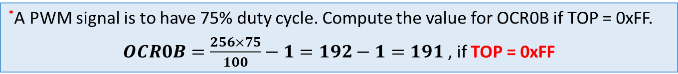
Programming Arduino for Fast PWM
#ifndef F_CPU
#define F_CPU 16000000UL // Clock frequency is 16 MHz
#endif
#include <avr/io.h>
int main() {
// OC0B pin is set as PWM output pin by sending a HIGH to Port D’s Data Direction Register, DDRD
DDRD |= (1<<PD5);
OCR0B = 191; // Load 191 into OCR0B for setting its duty cycle to 75% (See previous example, slide # 13*)
// Configure TCCR0A and TCCR0B register for (i) non-inverting (10), (ii) Fast PWM mode 3 (011),
// (iii) Pre-scalar (101) for frequency control. By default, 0s are there, but you may set them explicitly.
TCCR0A |= (1 << COM0B1) | (1<<WGM01) | (1<<WGM00);
TCCR0B |= (1<<CS02) | (1<<CS00); // CS02:00 = 101, N = 1024
// TCCR0A=0b00100011; TCCR0B=0b00000101
while(1);
return 0;
}
*A PWM signal is to have 75% duty cycle. Compute the value for OCR0B if TOP = 0xFF.
$OCR0B=\frac{256×75}{100}−1=192−1=191$ , if TOP = 0xFF

Slide 32
PWM
The difference between the mode 3(1) and mode 7(5) Fast PWMs is their TOP values.
For mode 3(1), the TOP value is fixed (0xFF), whereas that for mode 7(5) is OCRnA value.
If mode 7(5) is used, then we must load a count value into the OCRnA register.
Once a mode is selected, the timer/counter starts counting from BOTTOM to TOP value and when the TOP value is reached the counting is repeated from BOTTOM.
The table in the right shows the WGM bits combination for mode 3 and mode 7.

Slide 33
Fast PWM Mode: Setting Modes
In the fast PWM mode, the Compare Output Mode bits COM0A1, COM0A0 (in the TCCR0A register) for the output at OC0A and bits COM0B1, COM0B0 (in the TCCR0A register) for the output at OC0B, are used to configure the output as either non-inverting or inverting mode of operation. Table 12-3 shows how to select COM0A1, COM0A0 bits to generate non-inverting and inverting mode’s fast PWM waveform.

Slide 34
Fast PWM Mode: Setting Modes
In the fast PWM mode, the compare unit allows the generation of PWM waveforms on the OC0x pins. Table 12.6 shows the COM0B1:0 bits’ functionality when the WGM02:0 bits are set to the fast PWM mode.

Slide 35

Programming Arduino for Fast PWM
The waveform generated will have a frequency of
$f_{OC0BFPWM3}=\frac{f_{clk_IO}}{N×256}=\frac{16×{10}^{6}}{1024×256}=61.04$ Hz.

Slide 36
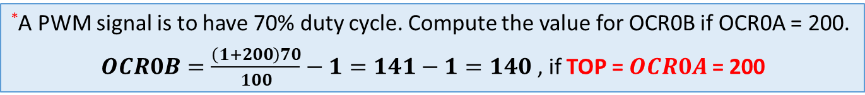
Programming Arduino for Fast PWM
#ifndef F_CPU
#define F_CPU 8000000UL // Clock frequency is 8 MHz
#endif
#include <avr/io.h>
int main() {
// OC0B pin is set as PWM output pin by sending a HIGH to Port D’s Data Direction Register, DDRD
DDRD |= (1<<PD5);
OCR0A = 200; // Top Value of 200 (must be equal or greater than the OCR0B)
OCR0B = 140; // Load 140 into OCR0B for setting its duty cycle to 70% (See previous example, slide # 13*)
// Configure TCCR0A and TCCR0B register for (i) non-inverting (10), (ii) Fast PWM mode 7 (111),
// (iii) Pre-scalar (011) for frequency control. By default, 0s are there, but you may set them explicitly.
TCCR0A |= (1 << COM0B1) | (1<<WGM01) | (1<<WGM00);
TCCR0B |= (1<<WGM02) | (1<<CS01) | (1<<CS00); // CS02:00 = 011, N = 64
// TCCR0A=0b00100011; TCCR0B=0b00001011
while(1);
return 0;
}
*A PWM signal is to have 70% duty cycle. Compute the value for OCR0B if OCR0A = 200.
$OCR0B=\frac{\left(1+200\right)70}{100}−1=141−1=140$ , if TOP = $OCR0A$= 200

Slide 37
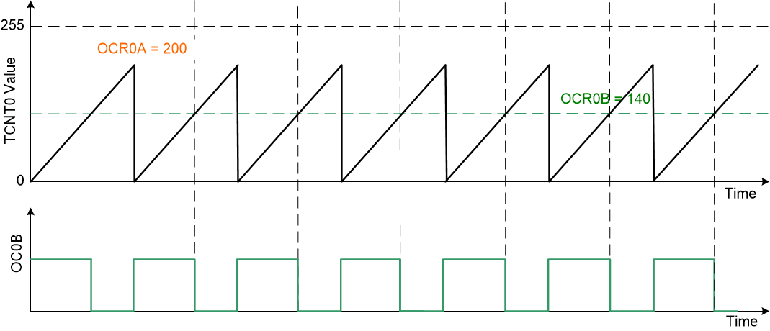

Programming Arduino for Fast PWM
The waveform generated will have a frequency of
$f_{OC0BFPWM7}=\frac{f_{clk_IO}}{N×\left(1+OCR0A\right)}=\frac{8×{10}^{6}}{64×\left(1+200\right)}≅622$ Hz.

Slide 38
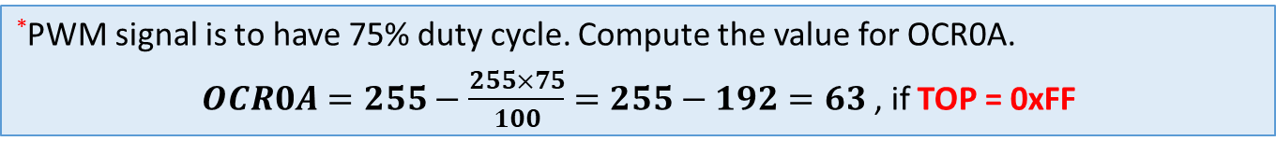
Programming Arduino for Phase-Correct PWM
#ifndef F_CPU
#define F_CPU 8000000UL // Clock frequency is 8 MHz
#endif
#include <avr/io.h>
int main() {
// OC0A pin is set as PWM output pin by sending a HIGH to Port D’s Data Direction Register, DDRD
DDRD |= (1<<PD6);
OCR0A = 63; // Load 63 into OCR0A for setting its duty cycle to 75% (See previous example, slide # 24*)
// Configure TCCR0A and TCCR0B register for (i) inverting (11), (ii) Phase-correct PWM mode 1 (001),
// (iii) No Pre-scalar (001) for frequency control. By default, 0s are there, but you may set them explicitly.
TCCR0A |= (1 << COM0A1) | (1 << COM0A0) | (1<<WGM00);
TCCR0B |= (1<<CS00); // CS02:00 = 001, N = 1
// TCCR0A=0b11000001; TCCR0B=0b00000001
while(1);
return 0;
}
*PWM signal is to have 75% duty cycle. Compute the value for OCR0A.
$OCR0A=255−\frac{255×75}{100}=255−192=63$ , if TOP = 0xFF

Slide 39

Programming Arduino for Phase-Correct PWM
The waveform generated will have a frequency of
$f_{OC0APCPWM1}=\frac{f_{clk_IO}}{N×510}=\frac{8×{10}^{6}}{1×510}≅15686.3$ Hz $≅15.7$ kHz.

Slide 40
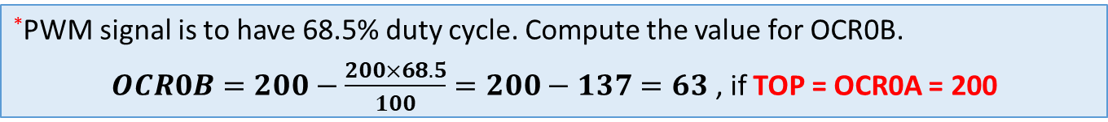
Programming Arduino for Phase-Correct PWM
#ifndef F_CPU
#define F_CPU 16000000UL // Clock frequency is 16 MHz
#endif
#include <avr/io.h>
int main() {
// OC0B pin is set as PWM output pin by sending a HIGH to Port D’s Data Direction Register, DDRD
DDRD |= (1<<PD5);
OCR0A = 200; // Load 200 into OCR0A as the TOP value in Phase-Correct PWM mode 5
OCR0B = 63; // Load 63 into OCR0B for setting its duty cycle to 68.5% (See previous example, slide # 24*)
// Configure TCCR0A and TCCR0B register for (i) inverting (11), (ii) Phase correct PWM mode 5 (101),
// (iii) Pre-scalar (100) for frequency control.
TCCR0A |= (1 << COM0B1) | (1 << COM0B0) | (1<<WGM00);
TCCR0B |= (1<<WGM02) | (1<<CS02); // CS02:00 = 100, N = 256
// TCCR0A=0b00110001; TCCR0B=0b00001100
while(1);
return 0;
}
*PWM signal is to have 68.5% duty cycle. Compute the value for OCR0B.
$OCR0B=200−\frac{200×68.5}{100}=200−137=63$ , if TOP = OCR0A = 200

Slide 41

Programming Arduino for Phase-Correct PWM
The waveform generated will have a frequency of
$f_{OC0BPCPWM5}=\frac{f_{clk_IO}}{2×N×OCR0A}=\frac{16×{10}^{6}}{2×256×200}=156.25$ Hz.

Slide 42
Thanks for attending….
?

